Slide 1
Contents of practice Autor: kolektiv autorů pod vedením prof. MUDr. Petra Zacha, CSc. z Ústavu Anatomie 3. LF UK
Reg. č. projektu: CZ.02.2.69/0.0/0.0/16_015/0002362
Toto dílo podléhá licenci Creative Commons licenci 4.0 Mezinárodní Licence
DNA isolation (concentration measurement)
PCR – amplification of HFE gene
Gel electrophoresis – verification of HFE gene PCR products
RFLP – restriction analysis of HFE gene
PCR – amplification of CFTR gene
Test

Slide 2
Tested mutations (the most frequent/severe)
Cystic fibrosis:
CFTR gene, chromosome 7
ΔF508 mutation
Hereditary hemochromatosis:
HFE gene, chromosome 6
C282Y + H63D mutations

Slide 3
CFTR gene: delta F508 mutation = deletion of phenylalanine (508th AA in protein chain)
Normal DNA
DNA 5´ … AAT ATC ATC TTT GGT GTT … 3´
Protein Asn Ile Ile Phe Gly Val
Position 505 506 507 508 509 510
Mutated DNA
DNA 5´ … AAT ATC AT - - - T GGT GTT … 3´
DNA 5´ … AAT ATC ATT - GGT GTT … 3´
Protein Asn Ile Ile - Gly Val
Position 505 506 507 - 509 510

Slide 4
HFE gene: C282Y mutation = substitution of cysteine by tyrosine (282nd AA in protein chain)
Normal DNA
5´...... TGC….. 3´
C – Cys – Cysteine (TGC) at position 282 of protein chain
Mutated DNA
5´...... TAC….. 3´
Y – Tyr – Tyrosine (TAC) at position 282 of protein chain

Slide 5
HFE gene: H63D mutation = substitution of histidine by asp. acid (63rd AA in protein chain)
Normal DNA
5´ ......CAT……3´
H – His – Histidine (CAT) at position 63 of protein chain
Mutated DNA
5´ ......GAT….. 3´
D – Asp – Aspartic acid (GAT) at position 63 of protein chain

Slide 6
ANALYSIS

Slide 7
DNA isolation
Basic steps:
Releasing of DNA into the solution = Cell lysis
Protein removal
Impurities removal
Measurement of DNA concentration (spectrophotometry, absorbance at 260 nm)

Slide 8
PCR (polymerase chain reaction)
Amplification of target DNA part in 30 – 40 cycles
Each cycle consist of: Denaturation
Annealing
Extension
Basic components of PCR:
DNA sample
Pair of primers (Forward + Reverse)
Free nucleotides (dATP, dTTP, dCTP, dGTP)
DNA polymerase

Slide 9
Basic types of PCR
General PCR
– target + complete analysis
– subsequent analysis of PCR product is needed
Allele specific PCR
– target analysis

Slide 10
HFE gene: mutation C282Y
PCR MIX per 1 sample (yellow tube):
H₂O 15.0 µl
buffer 2.5 µl
Mg²⁺ 2.0 µl
dNTP mix 0.5 µl
Primer 1 1.5 µl (PC1)
Primer 2 1.5 µl (PC2)
DNA 1.8 µl
Taq polymerase 0.2 µl (on ice)

Slide 11
HFE gene: mutation H63D
PCR MIX per 1 sample (blue tube)
H₂O 14.5 µl
buffer 2.5 µl
Mg²⁺ 2.5 µl
dNTP mix 0.5 µl
Primer 1 1.5 µl (PH1)
Primer 2 1.5 µl (PH2)
DNA 1.8 µl
Taq polymerase 0.2 µl (on ice)

Slide 12
Next step in analysis of mutation in hemochromatosis gene Subsequent analysis of PCR product

Slide 13
1) General PCR: Verification of PCR product using gel electrophoresis (mutation C282Y)
Amplified DNA
404 bp
390 bp
331 bp

Slide 14
2) RFLP – Restriction Fragment Length Polymorphism:
Restriction analysis of DNA by its digestion with restriction endonucleases (RE) in specific restriction sites
When the DNA sequence is different (polymorphism, mutation), it creates or disturbs a specific site for RE → after restriction, fragments with different sizes are formed

Slide 15
Restriction fragment length polymorphism
Restriction endonuclease (RE)
about 2100 bacterial REs known
RE recognizes variously short nucleotides sequences (4, 6, 8 ntds; usually palindromes), in which they digest covalent phosphodiester bonds
Principle of the analysis
DNA sample obtaining (genomic DNA, PCR product)
DNA sample digestion with a restriction enzyme into fragments of different sizes
DNA fragments separation by gel electrophoresis

Slide 16
Sequence of amplified DNA for C282Y mutation analysis
Healthy sequence
= no cleavage
5´- TGGCAAGGGTAAACAGATCCctctcctcatccttcctctttcctgtcaagtgccctcctttggtgaaggtgacacatcatgtgacctcttca gtgaccacactacggtgtcgggccttgaactactacccccagaacatcaccatgaagtggctgaaggataagcagccaatggatgccaaggagttcgaac ctaaagacgtattgcccaatggggatgggacctaccagggctggataaccttggctGTACcccctggggaagagcagagatatacGTGCcaggtgg agcacccaggcctggatcagcccctcattgtgatctggggtatgtgactgatgagagccaggagctgagaaaatctattgggGGTTGAGAGGAGTGC CTGAGgaggtaattatggcagtgagatgaggatctgctctttgttagggggtgggctgagggtggcaatcaaaggctttaacttgctttttctgttttagagccctca ccgtctggcaccctagtcattggagtcatcagtgga – 3´
G
A
Mutated sequence
= cleavage
5’- GTAC - 3’
3’- CATG - 5’
TAC: : restriction site for restriction endonuclease RsaI
Mutation C282Y: GTGC → GTAC
(restriction site is created by mutation)

Slide 18
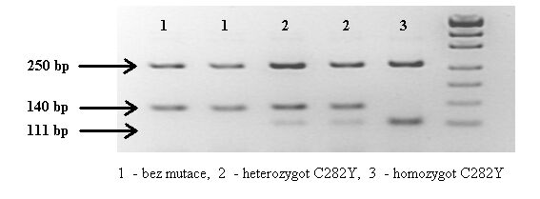
Evaluation of the results of the RFLP analysis
Mutation C282Y (v bp)
Healthy homozygote : 250 140
Homozygote with mutation : 250 111
Heterozygote : 250 140 111

Slide 19
Sequence of amplified DNA for H63D mutation analysis
Healthy sequence
= cleavage
5´– cagacacagctgatggtatgagttgatgcaggtgtgtggagcctcaacatcctgctcccctcctactacacatggttaaggcctgttgctct Gtctccaggttcacactctctgcactacctcttcatgggtgcctcagagcaggaccttggtctttccttgtttgaagctttgggctacgtggatgaccagctgttcgtgttc tatgatc atgagagtcgccgtgtggagccccgaactccatgggtttccagtagaatttcaagccagatgtggctgcagctgagtcagagtctg aaagggtgggatcacatgttcactgttgacttctggactattatggaaaatcacaaccacagcaaggg– 3´
C
G
Mutated sequence
= no cleavage
5’- TGATCA - 3’
3’- ACTAGT - 5’
GTAC: : restriction site for restriction endonuclease BclI
Mutation H63D: TGATCA → TGATGA
(restriction site is lost with mutation)

Slide 20
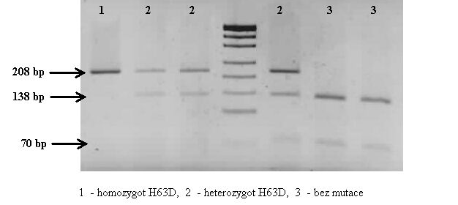
Evaluation of the results of the RFLP analysis
Mutation H63D (v bp)
Healthy homozygote: 138 70
Homozygote with mutation: 208
Heterozygote: 208 138 70

Slide 21
HFE gene mutations

Slide 22
HFE gene PCR product analysis – RFLP Method
Detection of mutation in PCR product of HFE gene using Restriction Fragment Length Polymorphism analysis.
Restriction mix – per 1 sample
Yellow tube (C282Y):
water 12.0 µl
buffer 1.4 µl
Yellow PCR product 7.0 µl
RE (RsaI) 0.7 µl
RE: restriction endonucleasis
Blue tube (H63D):
water 12.0 µl
buffer 1.4 µl
Blue PCR product 7.0 µl
RE (BclI) 0.7 µl

Slide 23
Detection of ΔF508 mutation in CFTR gene
Allele specific PCR:
This technique depends on the specificity of PCR primers
3 primers are made:
General primer (G)
Specific primer to normal sequence (N)
Specific primer to mutated sequence (M)
TARGET SEQUENCE
X
G
N
M

Slide 24
PCR reaction is performed in 2 tubes:
PCR mix M0 contains primer G and primer N
PCR mix M1 contains primer G and primer M
C/N
C/M
C/N
C/M
C/N
C/M
1
2
1
2
1
2
Homozygous
No Mutation
Heterozygous
Carrier
Homozygous
for Mutation

Slide 25
Detection of ΔF508 mutation in CFTR gene
Patient
1 2 3
DNA
marker
NC
+ + +
Mix M0
Control gene – control of PCR process
CFTR gene – general primer + primer specific to sequence without mutation
+ - +
Mix M1
Control gene – control of PCR process
CFTR gene – general primer + primer specific to
mutated sequence

Slide 27
Polymerase chain reaction (PCR) – mutation ΔF508 (cystic fibrosis)
PCR MIX – per 1 sample
PCR mix 0:
water 8.5 µl
buffer 2.0 µl
dNTP mix 4.0 µl
Mg²⁺ 2.0 µl
primers M0 1.2 µl
DNA 2.0 µl
Taq polymerase 0.4 µl
(on ice)
PCR mix 1:
water 8.5 µl
buffer 2.0 µl
dNTP mix 4.0 µl
Mg²⁺ 2.0 µl
primers M1 1.2 µl
DNA 2.0 µl
Taq polymerase 0.4 µl
(on ice)

Slide 28
Hemochromatosis
autosomal recessive disease affecting iron metabolism
excessive iron absorption, its deposition in organs (mainly parenchymal) and subsequent damage of the organism
hepatopathy (cirrhosis, hepatocellular carcinoma)
diabetes mellitus, arthropathy, hypogonadism, kardiomyopathy, amenorhea
serum iron, transferrin saturation, ferritin, liver biopsy
repeated phlebotomy

Slide 29
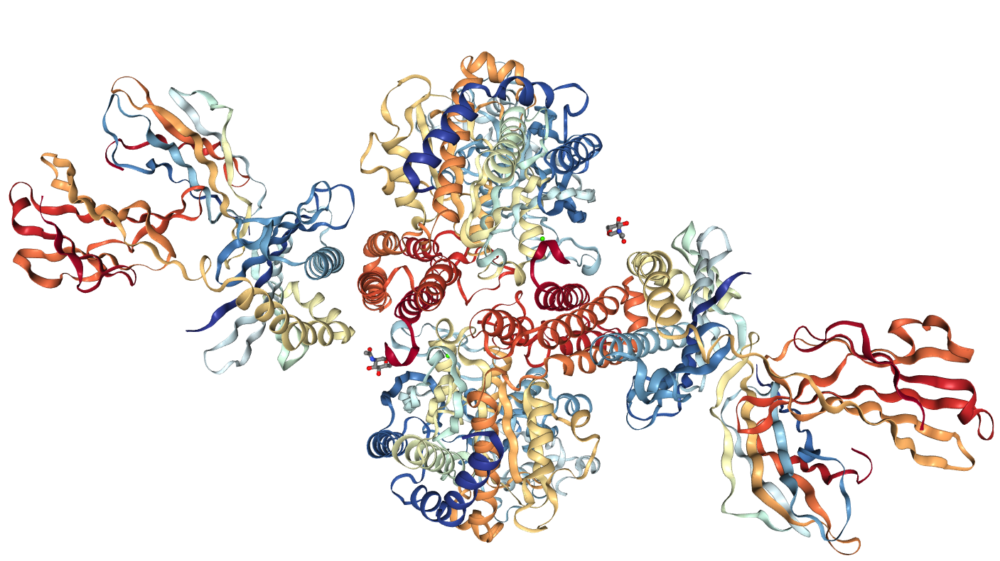
HFE-TFR2 interaction model
http://www.rcsb.org/3d-view/1DE4/1
H63
Signal seq. cleaved
H63 = H41
C282 = C260
C282
HFE
TFR

Slide 30
Cystic fibrosis
the most common autosomal recessive (AR)
disorder among Caucasians
chronic and progressive disease
median at death is ~ 35 years
Organs Affected by CF
Lung: thick accumulations of mucus, breathing difficulties,
frequent resp. infectious, permanent lung damage
Pancreas: exocrine pancreatic insufficiency
malabsorption of proteins and fats
Liver: plugging of small bile ducts, cirrhosis
GIT: intestinal obstruction-Meconium ileus (15-20% CF babies)
Reproduction: improper formation of Vas deferens
sterility (95% CF male)
Skin: CF patients have salt crystal formation on their skin
(sweat excessively)

Slide 31
Molecular causation of CF
mutations in the CFTR gene
CFTR gene coding for chloride channel protein: cystic fibrosis transmembrane conductance regulator – located on the plasma membrane of epithelial cells of the lungs, pancreas, sweat glands, and other tissues
cAMP regulated chloride channel
Cl⁻
TM- transmembrane
spanning domains
lumen
TM1
TM2
cytoplasm
NBD1
NBD2
NBD-nucleotide binding domains (ATP)
R
R-regulation domain (cAMPdep.)

Slide 32
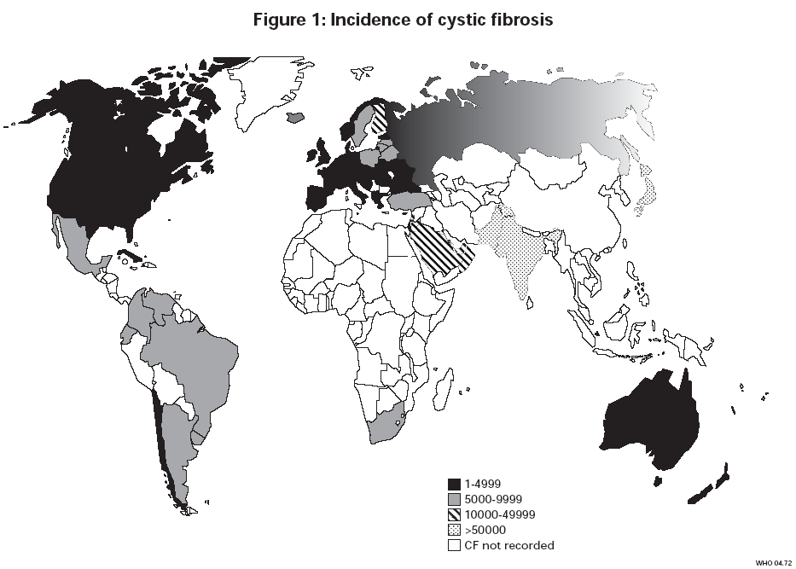
Mutation in the CFTR gene
germinal mutations
somatic mutations have not been described so far
de novo mutation – rarely
distribution of mutation shown population specificity

